Slide 1

Approximating the ground state energy of the molecular Hamiltonian
Amir Azzam
amir.azzam@students.salle.url.edu
Supervisors:
Dr. Xavier Vilasís Cardona
Dr. Parfait Atchadé Adelomou
Friday 15th of July – Room JH2.3

Slide 2
Presentation Structure
Introduction to the problem and the current limitations
Drug discovery process and its limitations
Current classical solutions
Proposed solution
Fundamentals and background
Quantum Computers and how they operate
Ground state energy and how to find it
Problems with quantum systems
Machine learning Model
Training the Model
Results and Conclusions

Slide 3
Introduction to the problem
The drug discovery process:
[1]
The First two stages of drug discovery (pre-clinical stages) can take up to 8 years of research
These two stages can be accelerated using classical computers
[1] : https://www.seikagaku.co.jp/en/development/flow.html

Slide 4
Current Classical Approaches
Density Functional (DF) Theory ^{[1]}
This method is used to calculate the electronic structure of molecules and be able to find the ground state energies of these molecules
Molecular Dynamics Simulations (MDS) ^{[2]}
This method is used for analyzing the physical properties of atoms and molecules in a quantum system
Artificial Intelligence (AI) ^{[3]}
Used in drug design, drug repurposing, or predicting the bio-activity and toxicity of a drug.
[1] : https://royalsocietypublishing.org/doi/10.1098/rsta.2012.0488
[2] : Jarosaw Meller et al. “Molecular dynamics”. In: Encyclopedia of life sciences 18 (2001)
[3] : https://www.ncbi.nlm.nih.gov/pmc/articles/PMC7577280/
Notes:
Write small description

Slide 5
Problems with classical methods
These methods are very slow to execute and do not always provide accurate results.
This creates a bottleneck to how much the drug discovery process can be accelerated.

Slide 6
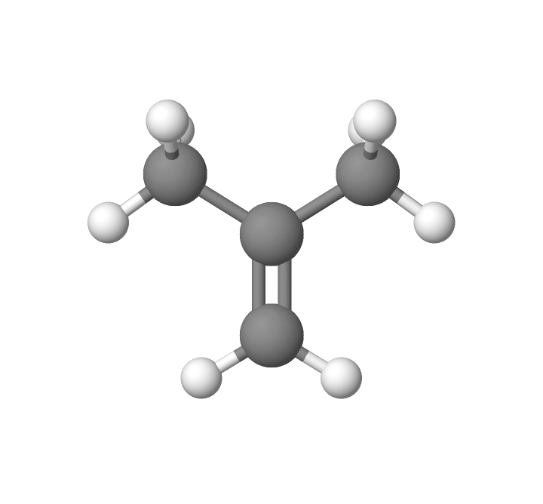
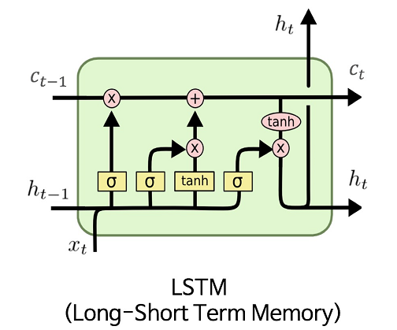
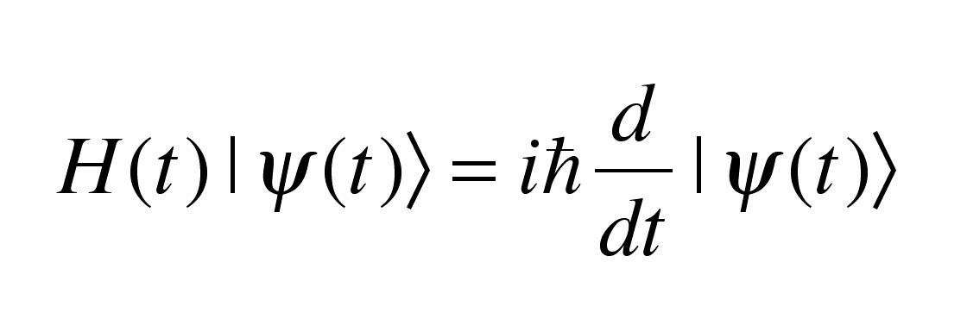
Proposed Solution
Generate data Using quantum computers
Train an LSTM model To predict the output of the quantum circuit
Predict the
ground state
Notes:
Predict the ground state energy of the molecular Hamiltonian out of the circuit needed to calculate that energy by the quantum computer, by training an LSTM model using data collected by a quantum computer.

Slide 7
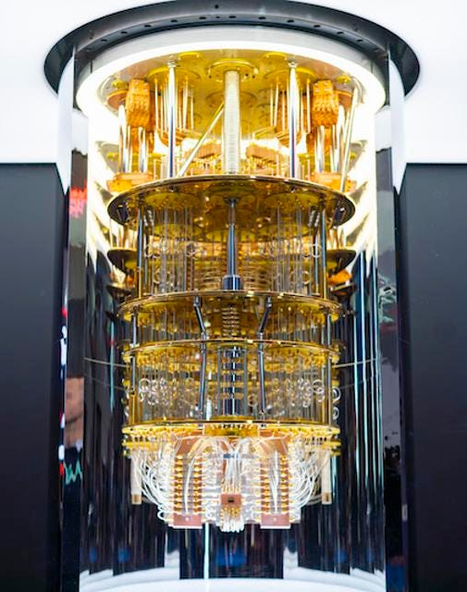
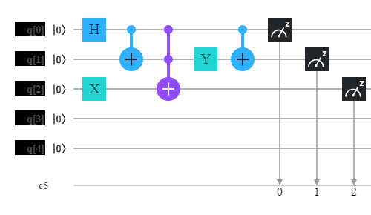

Quantum Computers
Qubit
Quantum Gates
IBM Q System one
Source: Noson S. Yanofsky and Mirco A. Mannucci. Quantum Computing for Computer Scientists. Aug. 2008. isbn: 978-0-521-87996-5. doi: 10.1604/9780521879965

Slide 8
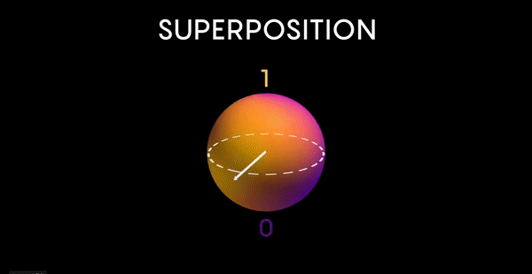

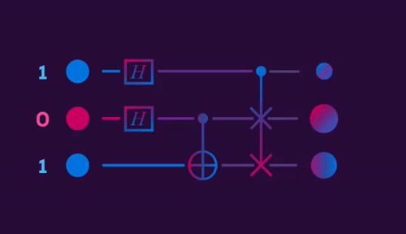
Principles of Quantum Computers
Superposition
Entanglement
Quantum Gates
Source: Noson S. Yanofsky and Mirco A. Mannucci. Quantum Computing for Computer Scientists. Aug. 2008. isbn: 978-0-521-87996-5. doi: 10.1604/9780521879965

Slide 9
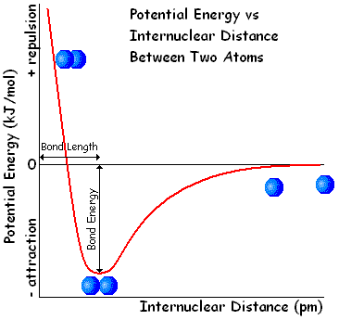
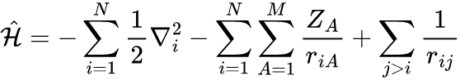
Ground State Energy
The Schrödinger Equation
Ground state energy
Source: https://www.reddit.com/r/askscience/comments/9exqpy/why_does_potential_energy_rapidly_increase_when/
The Hamiltonian for a molecule

Slide 10
Steps To Find the Ground State Energy
Compute gradients for all double excitations.
Select the double excitations with gradients larger than a pre-defined threshold.
Use the variational Quantum eigensolver (VQE) to obtain the optimized parameters for the selected double excitations.
Repeat steps 1 and 2 for the single excitations.
Perform the final VQE optimization with all the selected excitations
Source: https://pennylane.ai/qml/demos/tutorial_adaptive_circuits.html

Slide 11
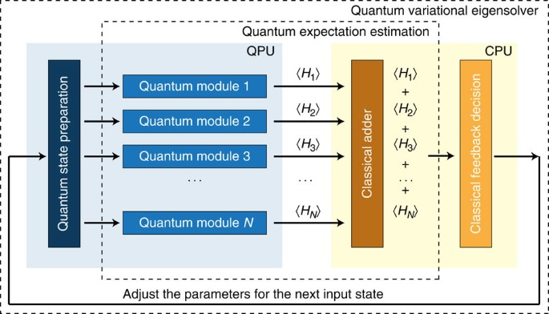
Hybrid approaches and algorithms
Example: The Variational Quantum Eigensolver (VQE)
Source: https://www.nature.com/articles/ncomms5213?origin=ppub

Slide 12
Problems with quantum computers
The lack of qubits in current quantum systems
As of last year, the maximum number of qubits offered by a quantum-gate based model is 127 qubits.
Current systems are still in the NISQ (Noisy Intermediate-Scale Quantum) era
Lack of quantum coherency
Source: John Preskill. “Quantum computing in the NISQ era and beyond”. In: Quan-tum 2 (2018), p. 79.

Slide 13

Machine learning Model
Recurrent Neural Network (RNN)
Used because they allow the training and testing data to have a variable length input.
Source: https://pydeeplearning.weebly.com/blog/basic-architecture-of-rnn-and-lstm

Slide 14
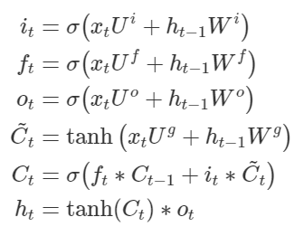
Long-Short Term Memory
Source: https://agustinus.kristia.de/techblog/2016/08/12/lstm-backprop/

Slide 15
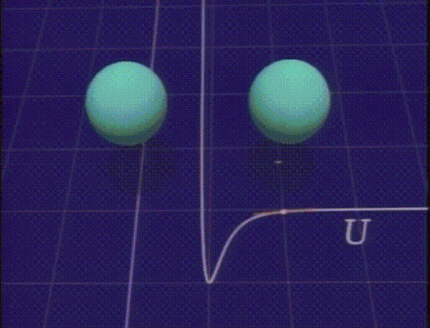
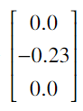
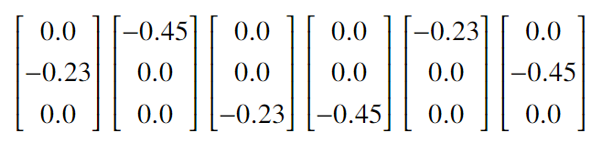
Training The Model
To generate the data:
+6.721
H = (−12.32) [𝐼0] + (−0.23) [𝑍1 𝑋2 𝑌0] + (−0.45) [𝑋0 𝑍1 𝑌2] = -5.599
X
Y
Z
Qubit 0
Qubit 1
Qubit 2
Around 490 Hamiltonians per molecule

Slide 16
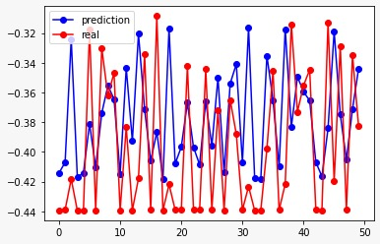
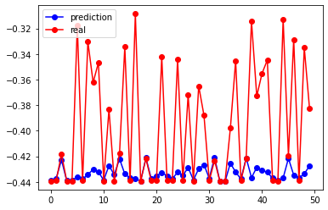
Model Results
Predicting O₂
(O₂ in training data)
Predicting O₂
(O₂ not in training data)
- Training the model with molecules that have 2 atoms, then tested with the Oxygen molecule (O₂)

Slide 17
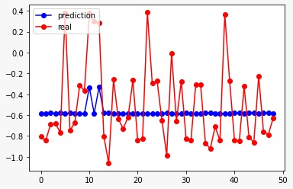
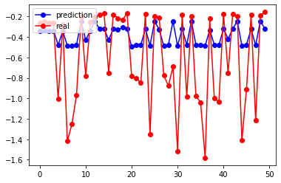
Discussion
Predicting H₂O
(No 3 atoms molecules in training data)
Predicting H₂O
(With 3 atoms molecules in training data)
- The difference between testing the model on a molecule with three atoms, if the model had 3 atoms molecules in the training data set and if it doesn’t.

Slide 18
Project Results
Designed a way to map the molecular Hamiltonian into vectors that can be used to train the LSTM model.
Tested 3 different mapping techniques (Text mapping, Matrix mapping, and vector mapping).
Built an LSTM model and an Adam optimizer from scratch

Slide 19
Conclusions and future lines
Learned how quantum computers work and how to map the molecules.
Learned how to use the different quantum framework like Pennylane, and Openfermion.
Learned how to use both classical and quantum computers to solve problems and overcome the current limitations of quantum computing.
More testing needs to take place and more models need to be tested with molecules of different structures.
In the future I will try different machine learning algorithms.
Try to talk to a quantum chemistry expert.
Notes:
with current computational resources available a conclusive result can not be reached to weather this hypothesis is possible or not.

Slide 20
Thanks for listening!
Amir Azzam
amir.azzam@students.salle.url.edu
Supervisors:
Dr. Xavier Vilasís Cardona
Dr. Parfait Atchadé Adelomou
Friday 15th of July – Room JH2.3

Slide 21
Annex

Slide 22
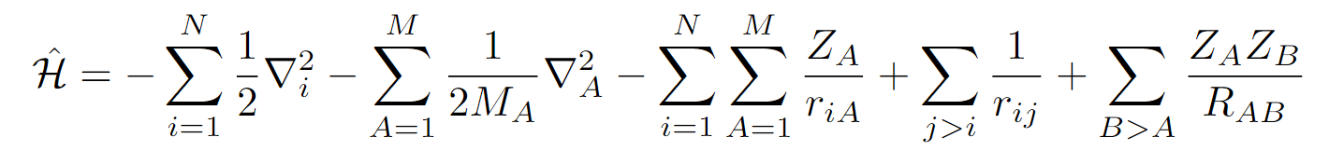
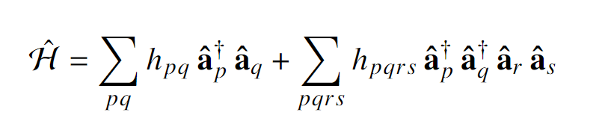
Equations
Hamiltonian:
In terms of creation and annihilation operators:
Electron Kinetic energy
nuclear Kinetic energy
Nuclei-electrons interaction
Electron-electron interaction
Nuclei-nuclei interaction

Slide 23
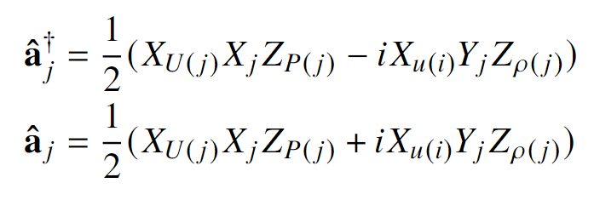
Equations
Bravyi-Kitaev transformation:
P(j) : Party set
U(j) : Update set
F(j) : Flip set

Slide 24
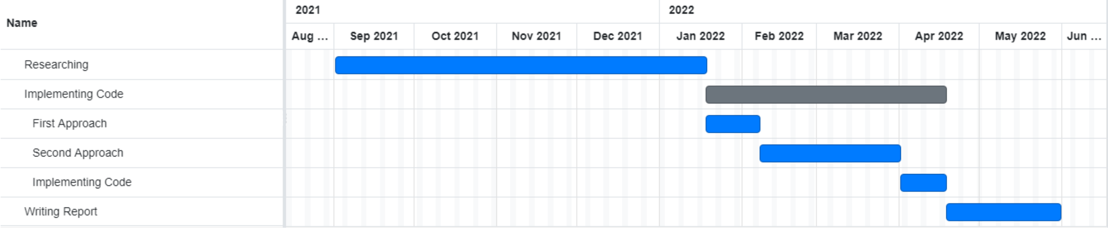
Temporal Cost

Slide 25
Computational Resources
Python 9
WSL 2
CPU: Intel Core i7-8750H @ 2.20GHz with 6 cores, 12 logical processors
GPU: NVIDIA GeForce GTX 1050 (Not used)

